Slide 1


D. Journic Phase 2 Project

Slide 2
Topics
This presentation will cover:
Business Problem
Data used
Models created and how
Further issues
Conclusion

Slide 3
Business Problem
Assist homebuyer in finding a fair price based on specific criteria:
Bedrooms
Bathroom
Living area
Lot size

Slide 4
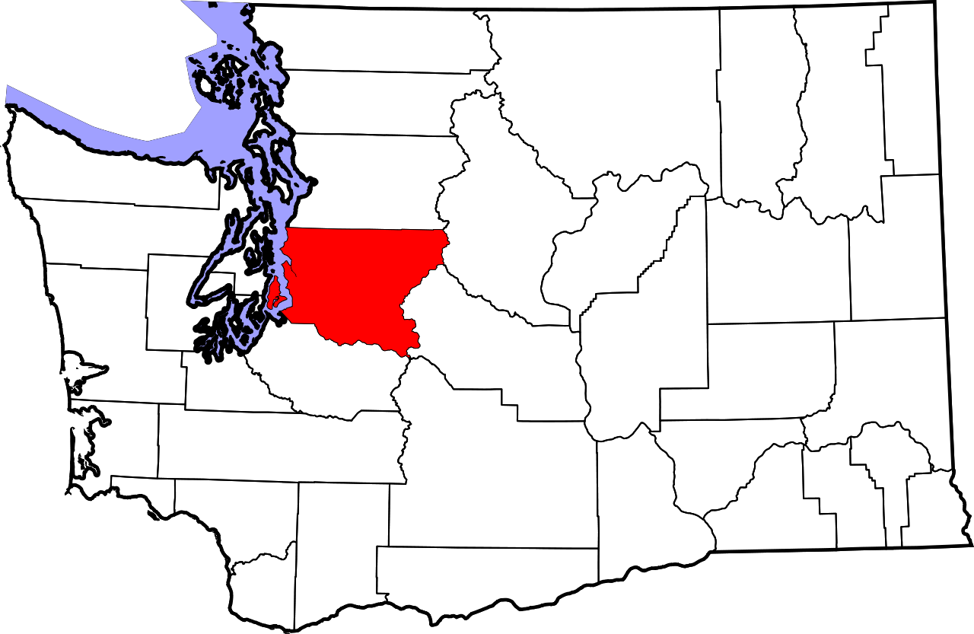
Data
Housing data from King County, WA
Approx 21,600 houses

Slide 5
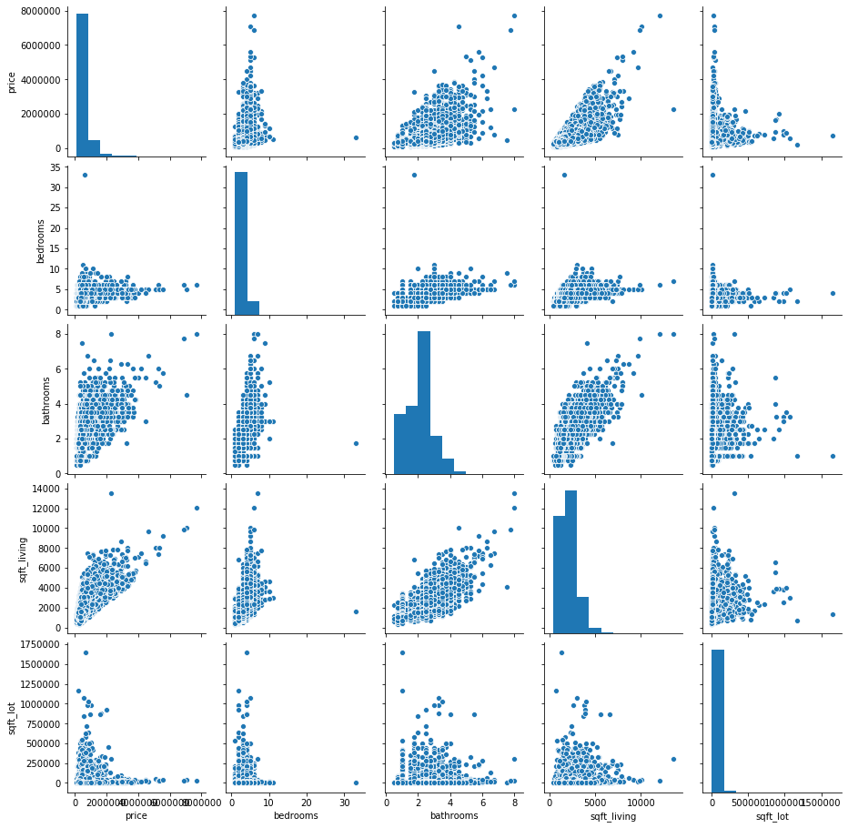
Variable Correlations
The highest correlation with price is living area (.64), followed by bathrooms (.47), then bedrooms (.31) and lot size (.089)

Slide 6
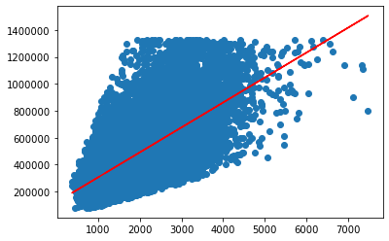
Simple linear regression
Living area and price.
R2= 0.415

Slide 7
Other models run:
Living area, lot, beds and baths Vs. Price (R2= 0.51)
LT Living area, LT lot Vs. LT Price (R2= 0.401)
LT Living area, LT lot, beds, baths Vs LT Price (R2= 0.402)
And many, many more…..

Slide 8
Estimator function:

Slide 9
Conclusions
After all the data manipulating and narrowing of scope, the best model is still the first with roughly 50% reliability.
More work is needed to improve the model.

Slide 10
Thank you. Questions?
djournic@gmail.com

